Slide 1






Team Name : AstroBytes
Category : Environment & Sustainability
Problem Statement : Helping coastal fishermen in India use technology to fish smarter, stay safe, and protect the environment.
Abstract : In many coastal areas of India, fishermen still depend on guesswork and past experience to find fish. This can waste fuel, cause accidents during bad weather, and even lead to crossing into other countries’ waters by mistake.
Our project Samudra Sahayak is a mobile app that gives fishermen real-time fishing zone suggestions, weather alerts, GPS-based border warnings, and the shortest safe route to fishing spots. It also supports local languages and works offline, making it easy to use even in remote sea areas. This will improve safety, save money, and protect marine life.

Slide 2
Proposed Solution
Samudra Sahayak is a mobile app made to help coastal fishermen in India fish in a smarter, safer, and more eco-friendly way. The app gives real-time information about good fishing spots, weather conditions, and sea safety. Before leaving the shore, fishermen can check where fish are likely to be, get alerts about bad weather, and see the shortest and safest route to travel. While fishing, the app warns them if they are getting close to another country's waters and guides them with voice instructions in their local language. It also works without the internet in low-network areas. After returning, fishermen can record the types and amounts of fish they caught, helping them plan better trips in the future. This saves fuel and time, prevents accidents, and supports sustainable fishing practices.

Slide 3
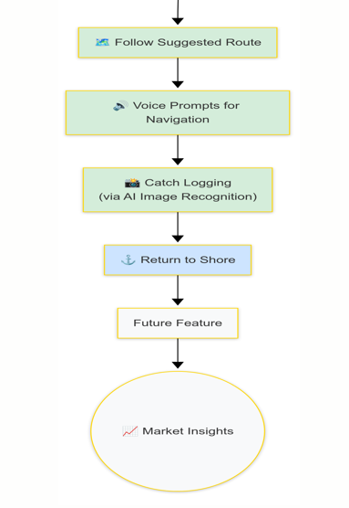
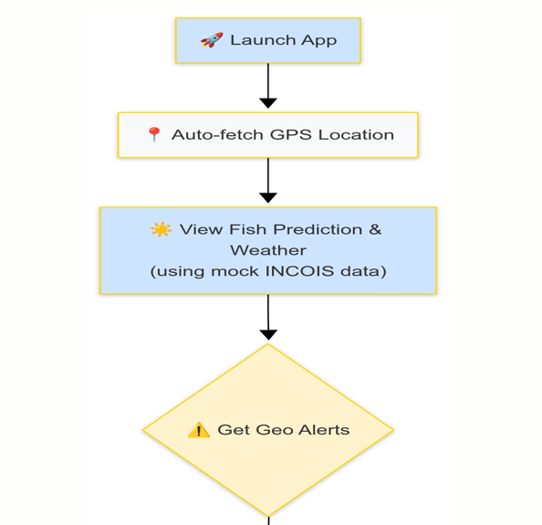
Flow Chart

Slide 4
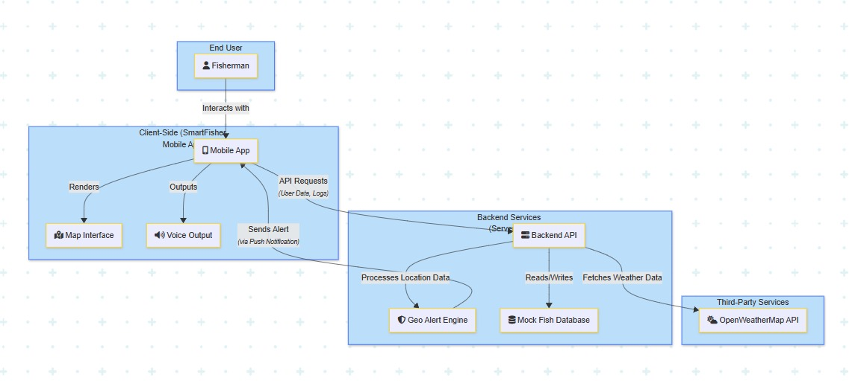
Architecture

Slide 5
.
Innovation and Unique Functionality
Our Unique Promise: The only all-in-one digital assistant designed for the unique challenges of India's coastal fishermen.
Simplifying the Day's Work with an integrated assistant that combines fish prediction, weather, maps, and compliance tools in one simple app.
Breaking Literacy Barriers through clear voice guidance in local languages, making advanced technology accessible to every single fisherman.
Ensuring 100% Reliability with an offline-first design that keeps critical maps and border alerts active, even far from the shore.
Saving Lives and Livelihoods with proactive, real-time warnings that prevent fishermen from accidentally crossing into other countries' waters.
Promoting a Sustainable Future by making it easy to log catches and be aware of seasonal bans, helping to protect marine life for generations to come.
Built for Real-World Conditions with a simple, user-friendly interface designed for quick and easy use on a boat, not in an office.

Slide 6
Technical Details
Component | Technology / Tools Used
Frontend | React Native / Flutter
Backend | Node.js + Express
Map Engine | OpenStreetMap + Leaflet.js
Weather API | OpenWeatherMap
Fish Prediction | Mock JSON (Future: ML with INCOIS)
Voice Support | Coqui TTS / Google TTS
Database | Firebase / Supabase
Deployment | Firebase Hosting / Vercel

Slide 7


Existing Solutions and Comparison
Feature | Fisher Friend App | INCOIS SMS | Samudra Sahayak (Our)
Marine Weather Alerts
Fish Zone Suggestions
Geo-fencing / Border Alerts
Local Voice Guidance
Route Optimization
Offline Support
Catch Records

